Slide 1
ISE-529 Predictive Analytics
Module 1: Introduction

Slide 2
Module Overview/Agenda
Introductions and Course Objectives
Introduction to Predictive Analytics
Course Approach and Grading
Getting Started with Python and Jupyter Notebook

Slide 3
Introductions and Course Objectives

Slide 4
Course Objectives
Develop an advanced level or proficiency with the primary classes of predictive modeling used by data scientists.
Develop skills in using the Python programming environment and the primary packages and tools currently used by data scientists.
Understand key concepts for measuring the performance of analytical models and key techniques for enhancing their performance.

Slide 5
Further Objectives
In addition to the formal course objectives, another goal is to prepare students for success in their careers in the analytics field. This includes:
Preparing for the job search that many will be undertaking as the program draws towards completion
Learning about the tools that are commonly used in corporate settings
Getting experience in preparing and presenting reports in a manner that is transferrable to corporate settings
Developing a literacy in the classic papers and concepts in the field

Slide 6
Introduction to Predictive Analytics

Slide 7
What is Predictive Analytics?
Predictive analytics is the process of using known results to create, process, and validate a model that can be used to forecast future outcomes.
Generally, we are trying to develop models for the relationships between one or more "inputs" ("independent" or "predictor" or "explanatory" variables) to one "output" attribute ("dependent" or "response" variable) in the data

Slide 8

Drew Conway’s Data Science Venn Diagram

Slide 9
Terminology
“It seems we have more terms than concepts here”
Data Science
Analytics
Business Analytics
Predictive Modeling
Data Mining
Big Data
Artificial Intelligence
Supervised Analytics
Deep Learning
Online Analytical Processing (OLAP)
Business Intelligence
Prescriptive Analytics
Machine Learning
Predictive Analytics
Unsupervised Analytics
Statistical Learning
Descriptive Analytics

Slide 10
Terminology
Data Science vs Analytics
Both are “umbrella terms” that are largely synonymous in general usage, but …
Analytics
Focus on inference (getting insights from data)
Emphasis on statistical techniques
Primary tools: R, SQL, SAS, Tableau
Data Science
Focus on prediction (predicting the future, or characteristics of previously unseen observations)
Emphasis on computational techniques
Primary tools: Python, Java

Slide 11
Terminology
Descriptive/Predictive/Prescriptive Analytics
Different objectives for the analytics work:
Descriptive Analytics
Focused on understanding what happened or what is happening
Uses both statistical and computational techniques
Often involves visualization
Predictive Analytics
Focused on predicting what will happen.
Model assessment and validation are important topics
Model bias/variance tradeoff
Underfitting/overfitting tradeoff
Prescriptive Analytics
Focused on recommending (or making) the business decisions based on data
Primary techniques include optimization and simulation

Slide 12
Terminology
Supervised vs Unsupervised Analytics
One fundamental division of analytical techniques:
Supervised Learning
The training data includes the response variable (the “answer”) that we are trying to model
Predictive modeling falls into this category
Unsupervised Learning
The training data does not include a response variable
Unsupervised learning is focused on understanding patterns in the data
Key unsupervised techniques include:
Clustering
Association Rule Mining/Collaborative Filtering
Outlier detection

Slide 13
Terminology
Statistical Learning vs Machine Learning
Machine Learning arose as a subfield of artificial intelligence
Statistical Learning arose as a subfield of statistics
There is now significant overlap in the terms
Machine learning emphasizes large scale applications and prediction accuracy
Statistical learning emphasizes models, their interpretability, and precision and uncertainty

Slide 14
Terminology
Regression vs Classification
Predictive modeling divides into two basic types:
Regression
Response variable (that we are trying to model and predict) is continuous
Regression models are assessed and selected based on some metric of the average “error” – difference between the value predicted by the model and the actual value (usually on separate “training data”)
Classification
Response variable (that we are trying to model and predict) is a category (discrete)
Binary classification (two possible classes) is the most common form
Classification models are assessed and selected based on some “misclassification rate” metric – percentage of time the value predicted by the model is wrong (usually on separate “training data”)

Slide 15

Terminology
Regression vs Classification
Note: the term “regression” is overloaded (has two different meanings)
Definition on previous slide (continuous response variable) is now standard
“Regression models” also have a historical definition tied to the linear regression equation ($Y= β_{0}+β_{1}X)$
So, we have the situation where a “logistic regression” model is NOT a regression model – it is a classification model.

Slide 16
Terminology
Other Confusing Terms
Artificial Intelligence – analytics which attempts to carry out tasks that are traditionally performed by humans
Chatbots
Healthcare diagnoses
Neural Networks – A specific machine learning algorithm that attempts to replicate the structure of human cognitive processes
“Deep Learning” – the new name for neural networks

Slide 17
A Data Science Taxonomy

Slide 18
A Data Science Taxonomy
Data Preparation and Understanding

Slide 19
A Data Science Taxonomy
Also referred to as:
Analytic Data Mart
Analytic Base Tables
Analysis Table
Data Matrix

Slide 20
A Data Science Taxonomy
Visualizing and summarizing relevant information about the enterprise

Slide 21
A Data Science Taxonomy
Analytics to examine data to understand “what happened” or “what is happening”

Slide 22
A Data Science Taxonomy
Analytics to examine data to predict “what will happen”

Slide 23
A Data Science Taxonomy
Analytics to examine data to make recommendations on “what should I do?”

Slide 24
A Data Science Taxonomy
Data Mining (ISE-535)
Data Analytics Consulting (ISE-534)
Data Management (ISE-559)
Data Mining (ISE-535)
Predictive Modeling (ISE-529)
Business Intelligence (ISE-543)
Optimization (ISE-530)

Slide 25
Course Approach and Grading

Slide 26
Course Approach
Structure
The course will be organized into eleven primary modules. Each module will be covered in 1-2 weeks and will include in-class exercises and one graded homework assignment.
For each module, I will identify textbook(s) chapters that I have used as primary resources. Students are encouraged to review these chapters prior to the corresponding lectures.

Slide 27
Course Approach
Modules
First half – “the linear model”
Introduction to Predictive Analytics and Python
Data Preparation and Modeling Introduction
Linear Regression Model Definition and Assessment
Linear Model Diagnostics and Validation
Linear Model Selection and Regularization
Second half – “extensions and ML models”
Classification Models
Generalized Linear Models and Poisson Regression
Moving Beyond Linearity
Tree-Based Models and Ensemble Models
Support Vector Machines
Introduction to Neural Networks

Slide 28
Course Logistics
Homework
All materials will be uploaded to Blackboard. Assignments will be posted on Blackboard but will be submitted using GradeScope.
Submission process is straightforward:
Only PDF files can be submitted
To prepare your solution for submission:
In Jupyter notebook, File -> Download as -> HTML
Open HTML in browser and “print to PDF”
After uploading your solutions PDF file to GradeScope, you will be prompted to map each rubric grading item to a page or pages in your file
A file with instructions is uploaded to Blackboard under this module

Slide 29
Course Logistics
Homework
The homework due date is generally the day of the next class after it is assigned.
See GradeScope for the official due date
I will set GradeScope to accept late submissions for two days after the due date
After the late due date, submissions will not be accepted
Students are allowed one “free” late submission. After that late submissions will be penalized 10 points (out of 100) unless approved by me in advance
No submissions will be accepted after the late submission due date
The lowest homework grade will be dropped

Slide 30
Course Logistics
Communications
We will use Piazza as our primary communications channel
https://piazza.com/class/l4yk8f5xgy66v5?cid=4#
Please post any questions you have there instead of sending me an email
If your message is only for me, send it as a private message on Piazza
Students are strongly encouraged to answer each other’s questions and to help clarify existing questions
This is one way to earn “class engagement” extra credit

Slide 31
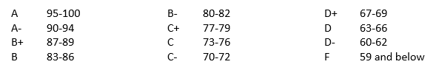
Grading
Grading will be based on the following components
Homework assignments that primarily consist of Python programming assignments (50%)
In-class mid-term (20%) and final exams (30%) on theory
In addition, up to 2 points may be added to the overall grade based on “class engagement”

Slide 32
Grading
Class engagement extra credit will be awarded at the discretion of the instructor based on:
Active participation during the lectures (can be done in class or online)
Active online participation in discussions and answering questions on Piazza
The mid-term and final exam will be during class time (see detailed class schedule in the syllabus)
The exams are open book and may be taken remotely, but you may not collaborate with other students
As noted earlier, the lowest homework grade will be dropped

Slide 33
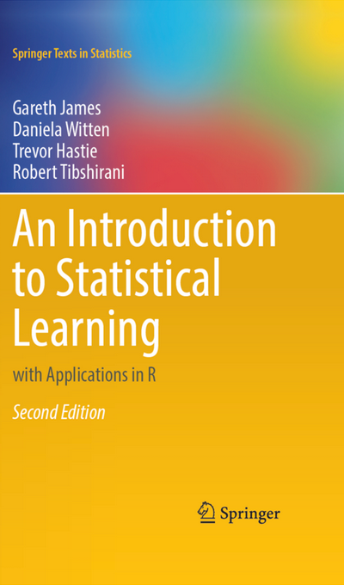
Texts
The “Core” Text
We will cover Chapter 1-10 of this text
The authors have made the book available for free on their website: https://www.statlearning.com/
The book uses R for some exercises. We will be doing similar exercises but using Python.
Additional texts are listed in the syllabus and will be referenced when I use materials from them

Slide 34
Office Hours
Instructor
In person: Monday/Thursday 3:00PM – 4:00PM (OHE 310u)
If you would like to join by Zoom, please let me know in advance. I will do my best to connect with you and answer your questions, but I will give priority to students who are in the office
I am open to scheduling Zoom office hour times by appointment
TAs
To be announced
Please check Piazza for any changes to these times!

Slide 35
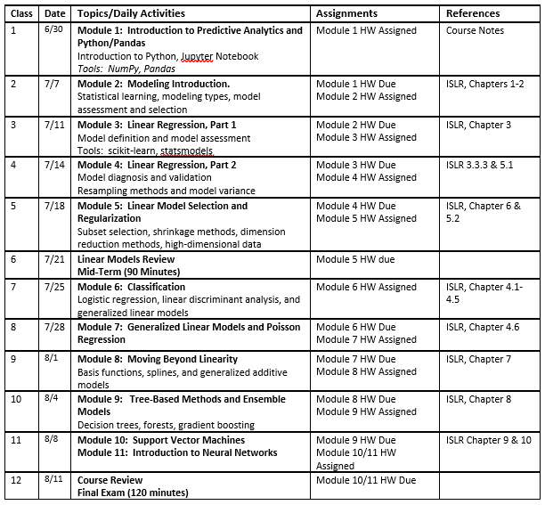
Detailed Class Schedule
Notes:
This schedule will almost certainly have to get adjusted as we move through the course. A current version of it will always be posted on Piazza
The schedule in the syllabus will not be updated throughout the semester
The assignment due dates here are not official. The official due dates will always be viewable on GradeScope

Slide 36
Introduction to Python

Slide 37
Core Tools of a Data Scientist
Mandatory:
SQL (ISE-559)
Python/Pandas (ISE-529)
R/Tidyverse (ISE-535)
Data modeling (ISE-559)
Excel
BI/Dashboarding
Tableau
PowerBI
SAS Visual Analytics (ISE-543)
Other analytical tools:
SAS
Matlab
Integrated data science platforms
SAS Viya (ISE-543)
IBM Watson Studio
Databricks
Tibco
Dataiku

Slide 38
Introduction to Python
Outline
Introduction to Python and Jupyter Notebook
Python basics
Control flow
Data structures and sequences
Functions
Libraries
NumPy
Pandas
Reading data from files
Plotting with Matplolib and Seaborn

Slide 39
Python Tutorials
Optional Learning Material
First, sign up for your free account:
Datacamp signup link
Once you have done that, I would recommend that you consider the following tutorials (depending on your skill levels):
Introduction to Python
Introduction to Data Science in Python - Parts 1 and 2
Data Manipulation with Pandas

Slide 40
Introduction to Python and Jupyter Notebook

Slide 41
Outline
Overview of Python, Jupyter Notebook, and the core data science libraries
Language Basics
Python
NumPy
Pandas
MatplotLib
Loading Data

Slide 42
Python
Open-source programming language developed by Guido van Rossum in the early 1990s
Named after Monty Python
Interpreted language (as opposed to compiled)

Slide 43
R or Python?
Both languages are used extensively by data scientists
Both include a large number of libraries for data analytics, data visualization, machine learning, web scraping, text analytics, and deep learning
R is focused heavily on statistical learning/data analysis.
Python is a more general-purpose language
We will focus on using Python as data science tool

Slide 44
The Python Ecosystem
A collection of
Python language (currently version 3.9)
Integrated development environments (IDEs - we will use Jupyter Notebook)
Libraries
The Anaconda distribution bundle contains everything needed for typical data science uses.

Slide 45
Why Jupyter Notebook?
Data Science IDEs vs Developer IDEs
Data Science IDE
Data-centric
Interactivity, visualizations, variable explorer
Less code complexity, scripts
Integration with data sources
Models and narratives/storytelling
Developer IDE
Code-centric
Classes, debugging, profiling
More complex code, programs
Integration with git, build tools, compilers
Tools and libraries/functionality

Slide 46
Major IDEs
Data Science IDEs
Jupyter
Spyder
RStudio
Developer IDEs
PyCharm
Pydev
Wing IDE
Sublime text
Visual studio

Slide 47
Installing Python and Jupyter Notebook Using Anaconda
Go to www.anaconda.com
“Get Started”
“Download Anaconda Installers”
Select the appropriate operating system for your use
Executing the Jupyter Notebook program opens the IDE in a browser

Slide 48
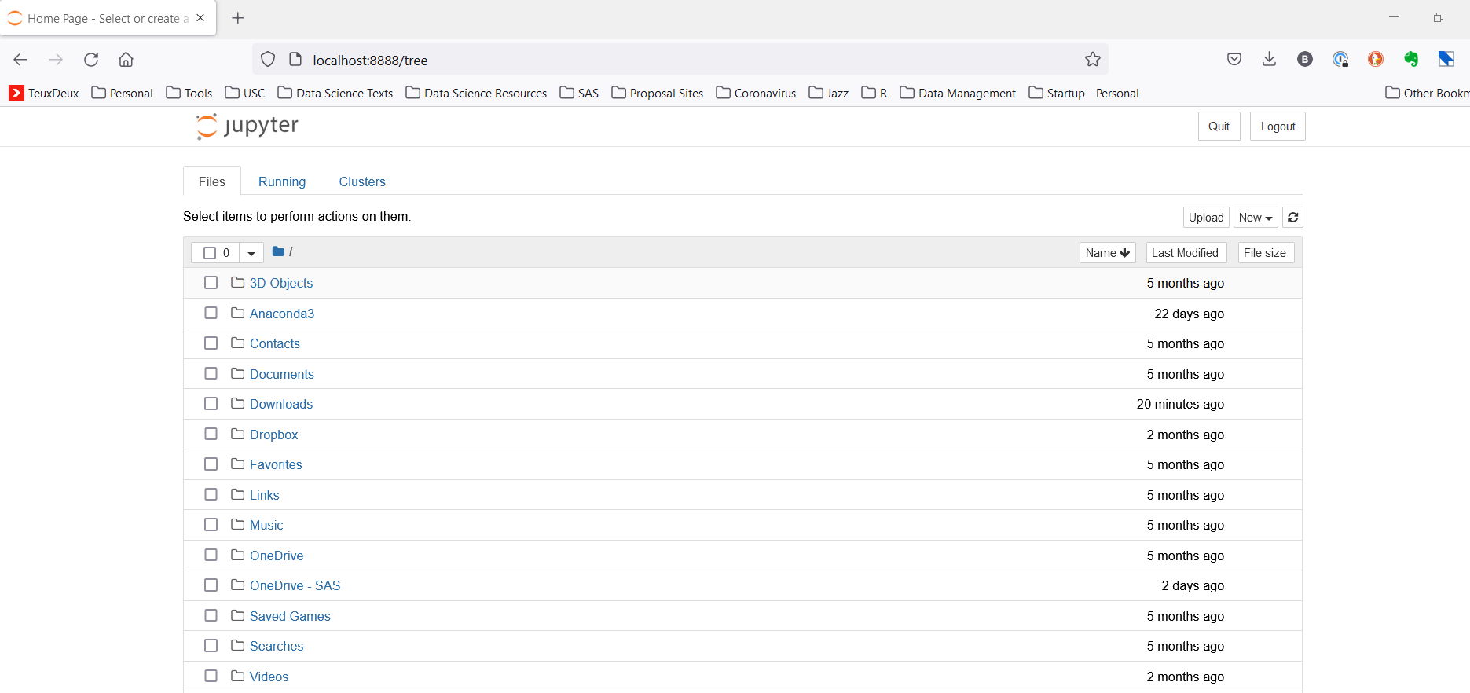
Getting Started With Jupyter Notebook
Dashboard
Navigate to the folder you want as your working area
Create a new notebook

Slide 49
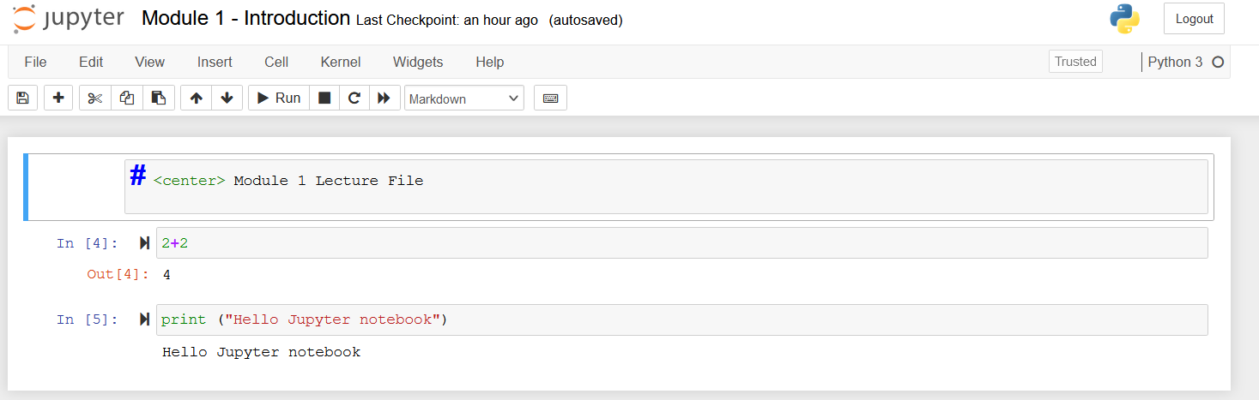
Getting Started With Jupyter Notebook
A notebook consists of a collection of cells which are either code cells or
Markdown cells
Run all the cells in the notebook
Specify the type of cell
Keyboard input modes:
Edit mode (green ribbon)
Command mode (blue ribbon)
Execute the code in the cell (also can be done by hitting control-Enter)
Jupyter Notebook Markdown Guides:
https://medium.com/analytics-vidhya/the-ultimate-markdown-guide-for-jupyter-notebook-d5e5abf728fd https://www.ibm.com/docs/en/watson-studio-local/1.2.3?topic=notebooks-markdown-jupyter-cheatsheet

Slide 50
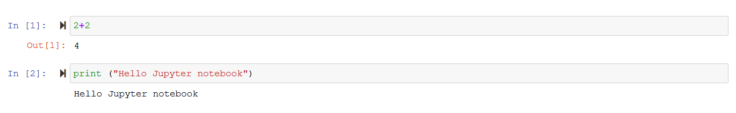
Python Basics
Python is an “interpreted” language, meaning that you can type a Python command (or string of commands) and get an immediate result:

Slide 51
Basic Datatypes
Integers (default for numbers)
Floats
Strings
Specified with “” or ‘’: “abc” = ‘abc’
Unmatched can occur within string: “matt’s”

Slide 52
Python Basics
Whitespace is meaningful in Python!
Especially indentations and placement of newlines
Use a newline to end a line of code
Use \ when you want to continue a Python commandment onto a new line
No braces {} to mark blocks of code in Python
Use consistent indentation instead
First line with more indentation starts a nested block
First line with less indentation is outside of the block
Often a colon appears at the start of a new block (e.g., for function definitions)

Slide 53
Comments
Start comments with # - the rest of the line is ignored
Can optionally include a “documentation string” as the first line of any new function you define (recommended):
def my_function (x,y):
“””Docuentation string goes here””” # Code goes here

Slide 54
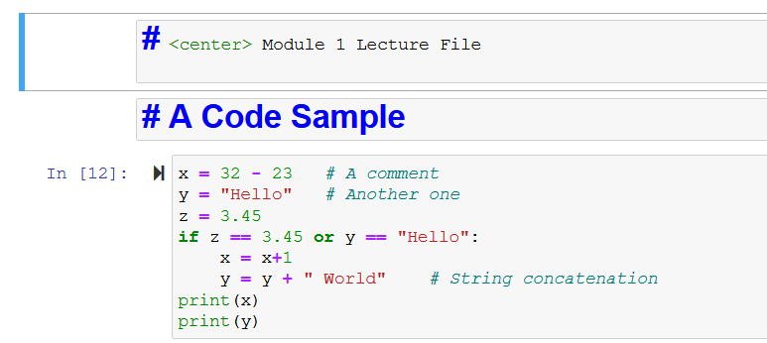
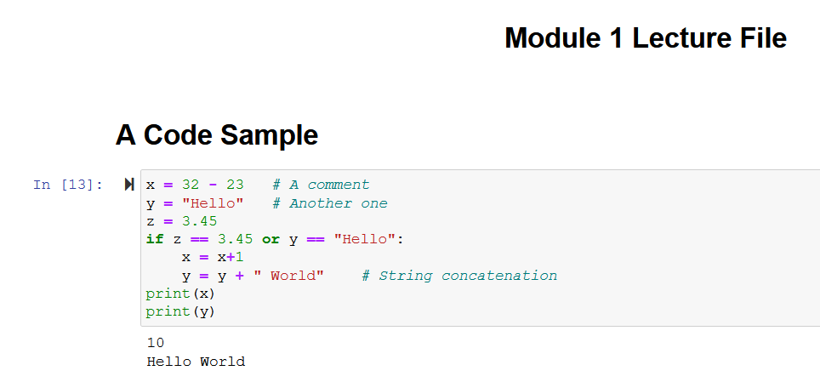
Python Basics
Comment text preceeded by a # is ignored
The first assignment to a variable creates it
Assignment uses =, comparison uses ==
Indentation and white space matter to the meaning of the code!
For numbers + - * / % are as expected
Logical operators are words (and, or, not) and not symbols
Simple printing can be done with print()

Slide 55
Built-In Python Scalar Data Types
Type | Description
None | The Python “null” value (only one instance of the None object exists)
str | String type; holds Unicode (UTF-8 encoded) strings
bytes | Raw ASCII bytes (or Unicode encoded as bytes)
float | Double-precision (64-bit) floating-point number (note there is no separate double type)
bool | A True or False value
int | Arbitrary precision signed integer
Note: using Python modules can add additional data types. For example, the datetime module provides datetime, date, and time types

Slide 56
Assignment
“Binding a variable” in Python means setting a “name” to hold a “reference” to some “object”
Assignment creates references, not copies!
A name is created the first time it appears on the left side of an assignment expression:
x = 3

Slide 57
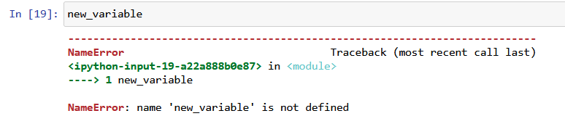
Accessing Non-Existent Names
If you try to access a name before it’s been created, you’ll get an error:

Slide 58
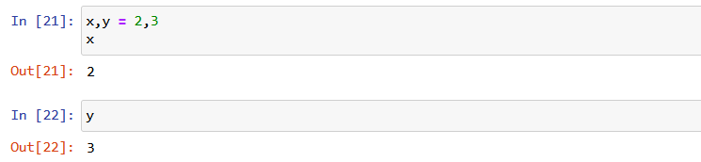
Multiple Assignment
You can also assign multiple names at the same time:

Slide 59
Naming Rules
Names are case sensitive and cannot begin with a number
They can contain letters, numbers, and underscores
bob Bob _bob _2_bob_ bob_2 BoB (all different)
Python has “reserved words” that cannot be used:
and, assert, break, class, continue, def, del, elif, else, except, exec, finally, for, from, global, if, import, in, is, lambda, not, or, pass, print, raise, return, try, while

Slide 60
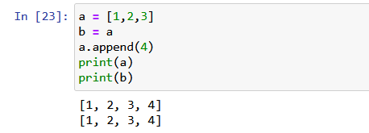
Python Reference Semantics
Assignment (x=y) makes x reference the object y references
Assignment does not make a copy of the object y references!

Slide 61
Python Basics
Objects and Functions
Everything in Python is an object
Each object has an associated type, data, attributes, and methods
Attributes are characteristics of the object
Methods are basically pre-defined functions that are called by appending to a variable a “.” followed by the method name:
Function call: result = some_function(x,y,x) Assigns the result to the variable result
Object method: obj.some_method(x,y,z) Performs an action using internal data in the object

Slide 62
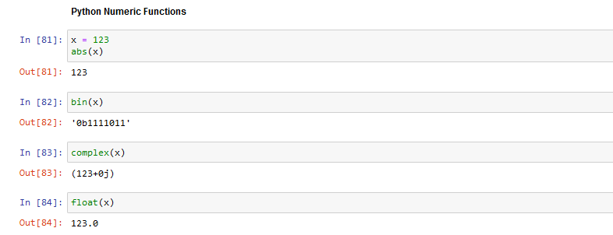
Python Basics
Numeric Functions

Slide 63
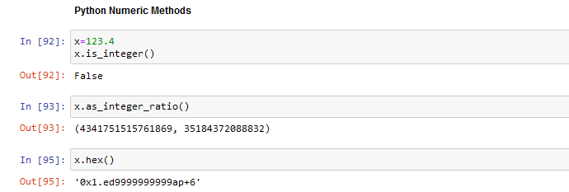
Python Basics
Numeric Methods

Slide 64
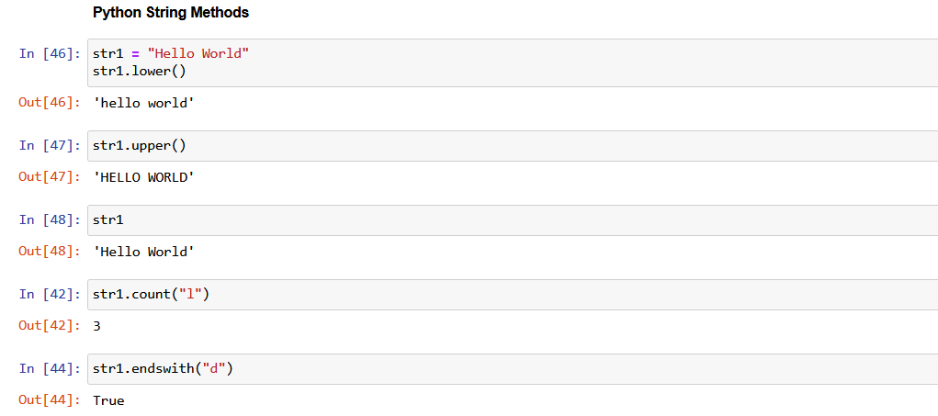
Python Basics
String Methods
Python string methods documentation: https://docs.python.org/3/library/stdtypes.html#string-methods

Slide 65
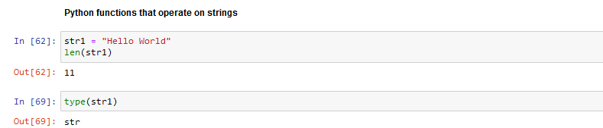
Python Basics
String Functions

Slide 66
Methods vs Functions
What’s the Difference? Why Both??
Generally, methods and functions are very similar and you will often see the terms used interchangeably (but don’t you do that!)
Methods are specific to object types (more on that later) while functions can apply to multiple object types
Another confusion is whether or not the calling object is modified
Functions never change the calling object
Methods sometimes do and sometimes don’t (caution is needed)

Slide 67
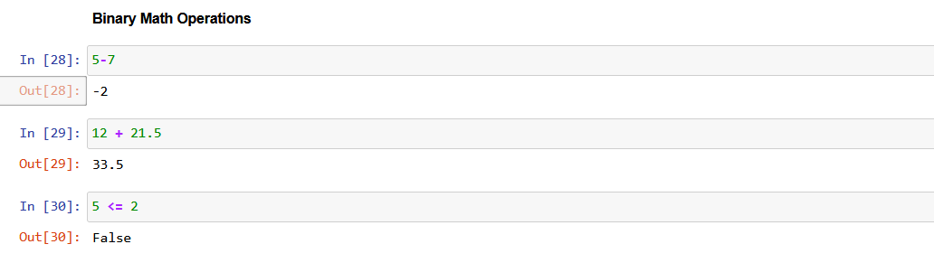
Binary Math Operations
Most binary math operations and comparisons operate as expected:

Slide 68
Binary Operators
Operation | Description
a + b | Add a and b
a - b | Subtract b from a
a * b | Multiply a by b
a / b | Divide a by b
a // b | Floor-divide a by b, dropping any fractional remainder
a ** b | Raise a to the b power
a & b | True if both a and b are True; for integers, take the bitwise AND
a | b | True if either a or b is True; for integers, take the bitwise OR
a ^ b | For booleans, True if a or b is True, but not both; for integers, take the bitwise EXCLUSIVE-OR

Slide 69
Binary Boolean Operators
Operation | Description
a == b | True if a equals b
a != b | True if a is not equal to b
a <= b, a < b | True if a is less than (less than or equal) to b
a > b, a >= b | True if a is greater than (greater than or equal) to b
a is b | True if a and b reference the same Python object
a is not b | True if a and b reference different Python objects

Slide 70
Python Language Basics
Control Flow

Slide 71
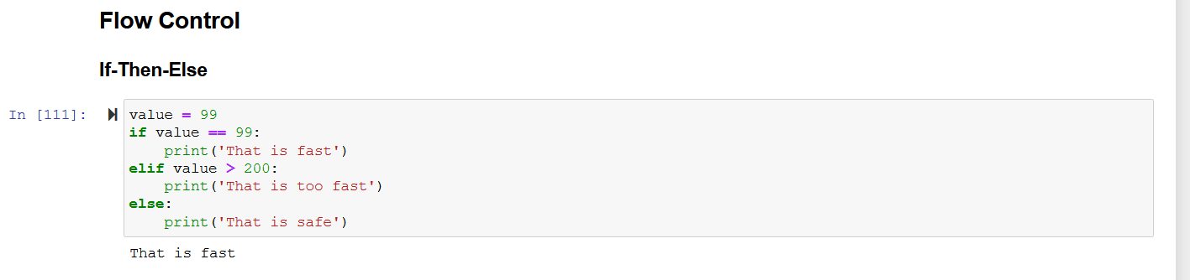
Language Basics
Flow Control

Slide 72
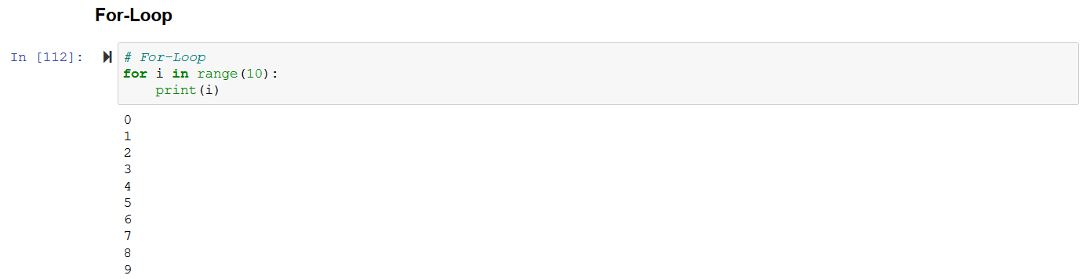
Language Basics
Flow Control

Slide 73
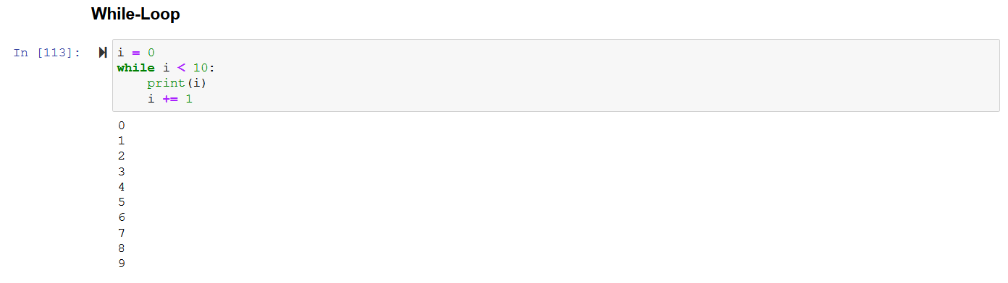
Language Basics
Flow Control

Slide 74
Python Language Basics
Data Structures and Sequences

Slide 75
Basic Python
Data Structures
Ordered Data Structures (Sequences)
List: Mutable (changeable) ordered sequence of items of mixed types
Tuple: An immutable (unchangeable) ordered sequence of items of mixed types
Unordered Data Structures
Set: Unordered and unindexed collection of unique elements
Dictionary: Ordered collection of key-value pairs
Also referred to as a hash map or an associative array

Slide 76
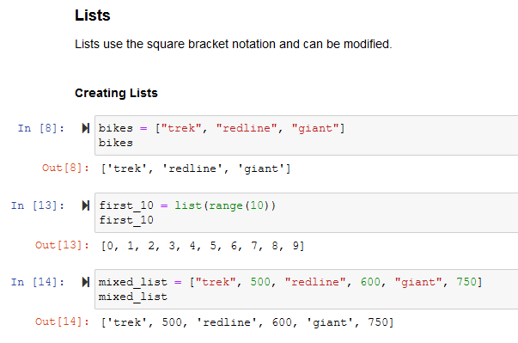
Base Python Data Structures: Lists
Lists: The “Workhorse” of Vanilla Python

Slide 77
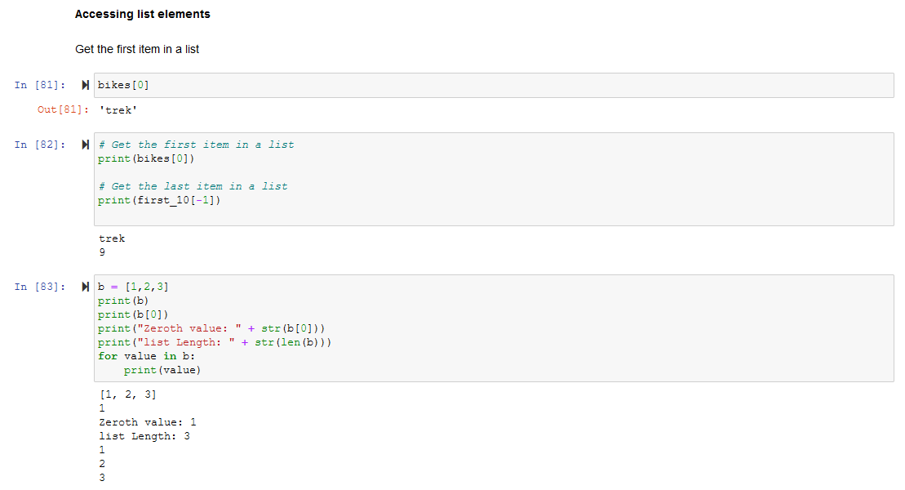
Base Python Data Structures: Lists
Accessing List Elements

Slide 78
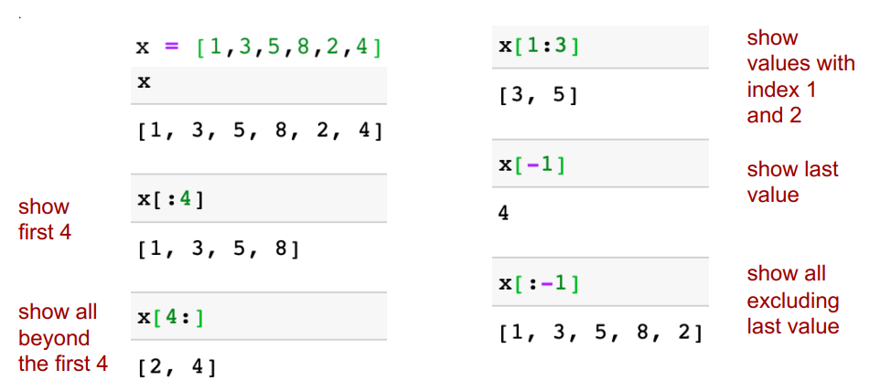
Base Python Data Structures: Lists
“Slicing” a List

Slide 79
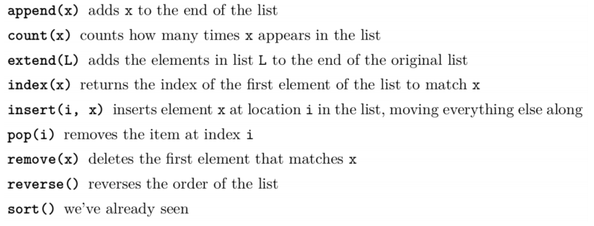
Base Python Data Structures: Lists
Functions for Lists

Slide 80
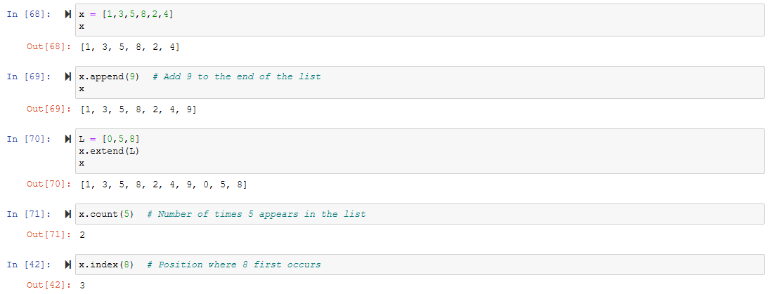
Base Python Data Structures: Lists
Methods That Operate on Lists

Slide 81
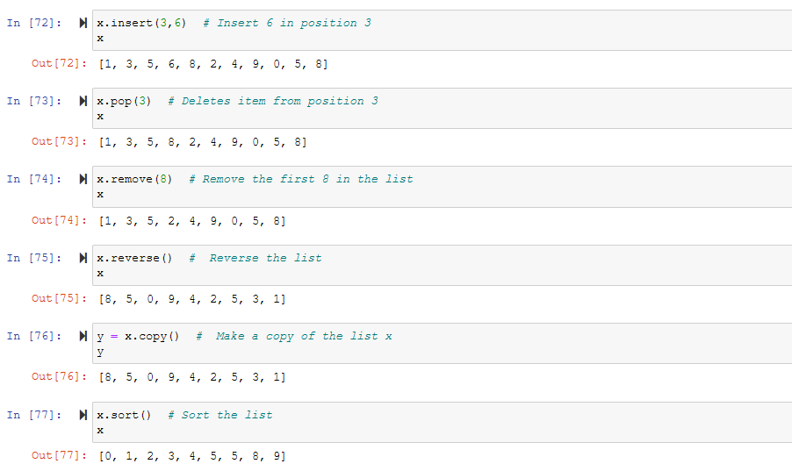
Base Python Data Structures: Lists
Methods That Operate on Lists

Slide 82
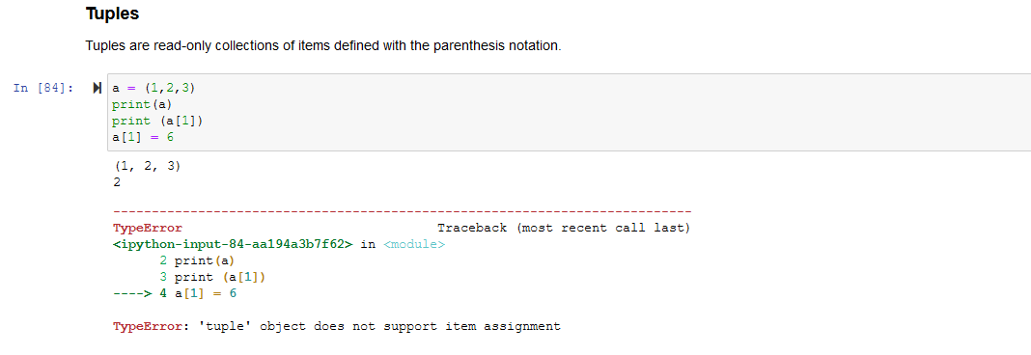
Base Python Data Structures: Tuples
Tuples
Tuples are similar to lists, but the items in a tuple can’t be modified
Uses () notation instead of [] used by lists

Slide 83
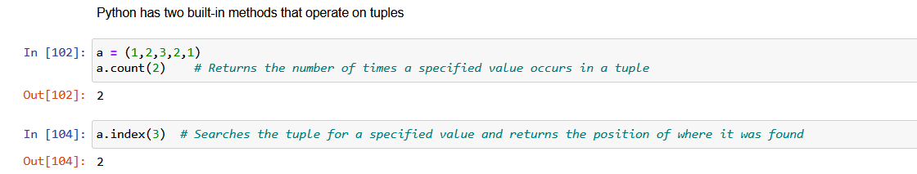
Base Python Data Structures: Tuples
Methods That Operate on Tuples

Slide 84
Why Does Python Have Tuples?
Efficiency. Tuples are much quicker for Python to process than lists
Protection. Sometimes you want to make sure that a tuple never gets modified, particularly when each element has semantic value
time.localtime()
(2008, 2, 5, 11, 55, 34, 1, 36, 0)
# Each element of the tuple has a specific meaning (year, month, day, etc.) and you wouldn’t want any individual item deleted
range(10)
[0, 1, 2, 3, 4, 5, 6, 7, 8, 9]
# We may care about the order, but individual values are functionally equivalent

Slide 85
Sets
Unordered, immutable sequences with no duplicate values
Highly efficient data structure for search, add, and delete opeations
Implemented with a hash table, not a linked list

Slide 86
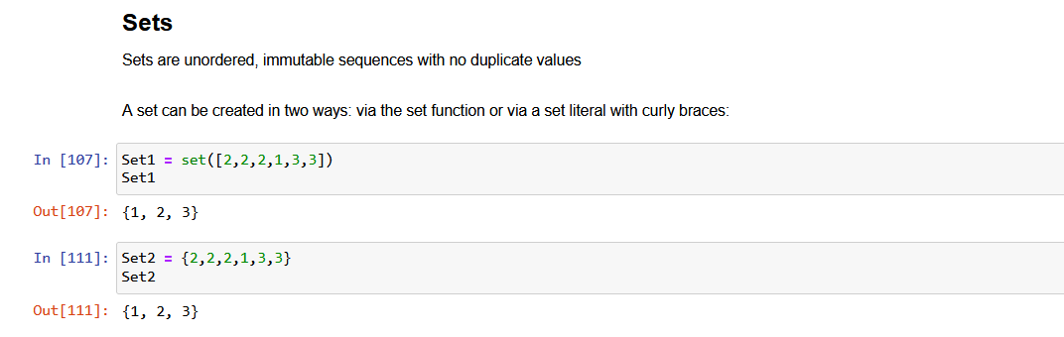
Base Python Data Structures: Sets
Sets

Slide 87
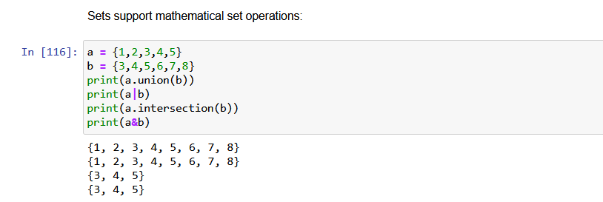
Base Python Data Structures: Sets
Sets

Slide 88
Base Python Data Structures: Sets
Commonly Used Set Methods
Function | Alternate Syntax | Description
a.add(x) | N/A | Add element x to the set a
a.clear() | N/A | Reset the set a to an empty state, discarding all of its elements
a.remove(x) | N/A | Remove element x from the set a
a.pop() | N/A | Remove an arbitrary element from the set a, raising KeyError if the set is empty
a.union(b) | a | b | All of the unique elements in a and b
a.update(b) | a |= b | Set the contents of a to be the union of the elements in a and b
a.intersection(b) | a & b | All of the elements in both a and b
a.intersection_update(b) | a &= b | Set the contents of a to be the intersection of the elements in a and b

Slide 89
Dictionaries
A mapping between a set of indices (keys) and a set of values
Each item in a dictionary is a key-value pair
Keys can be any Python data type, but because they are used for indexing, they should be immutable
Values can be any Python data type
Values can be mutable or immutable

Slide 90
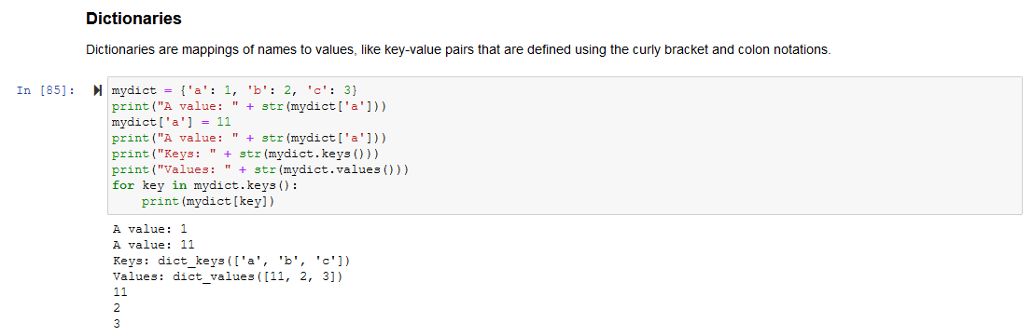
Base Python Data Structures: Dictionaries
Dictionaries

Slide 91
Comprehensions
Comprehensions provide a short and concise way to construct new sequences (such as lists, sets, dictionaries, etc.) using sequences that have already been defined

Slide 92
Comprehensions
List Comprehnsions
Basic format:
output_list = [output_exp for var in input_list if (var satisfies this condition)]
Equivalent for-loop:
result = []
for val in collection:
if condition:
result.append(expr)

Slide 93
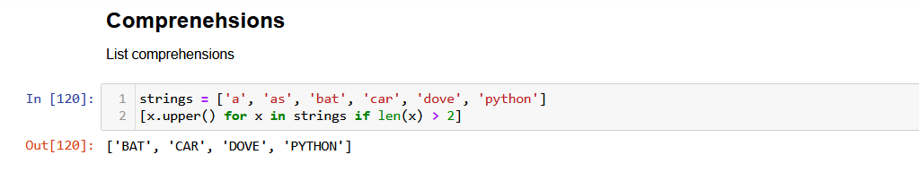
Comprehensions
List Comprehension Example

Slide 94
Functions

Slide 95
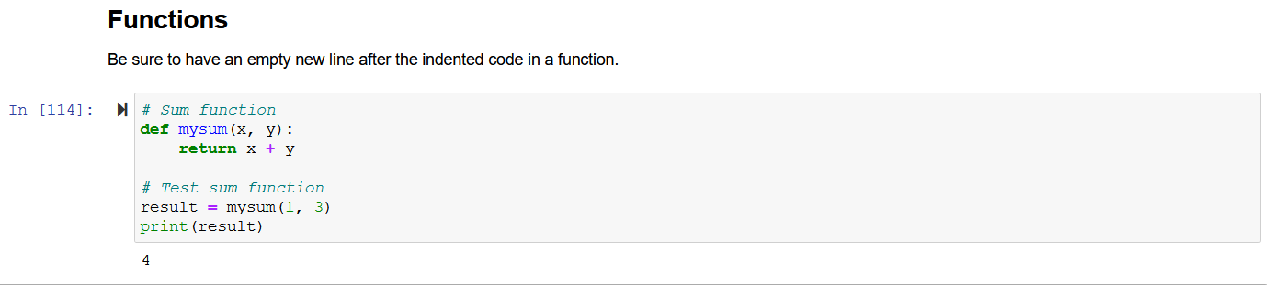
Language Basics
Functions
Function definition begins with def
Function name and its arguments
Colon
“return” indicates the value to be returned from the funtion
First line with less indentation is considered to be outside of the function devinition

Slide 96
Functions Without Returns
All functions in Python have a return value
Even if no return line inside the code
Functions without a return return the special value None
None is a special constant
None is also logically equivalent to False

Slide 97
Functions Are Objects
Functions can be used like any other data
Assigned to variables
Parts of tuples, lists, etc
Arguments to other functions
Return values of functions

Slide 98
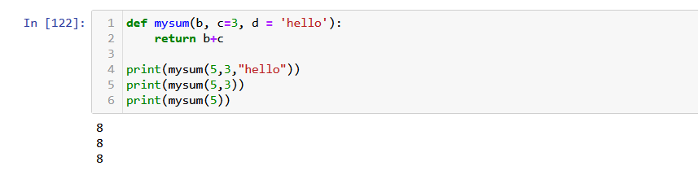
Default Values for Arguments
You can provide default values for a function’s arguments
These arguments are optional when the function is called

Slide 99
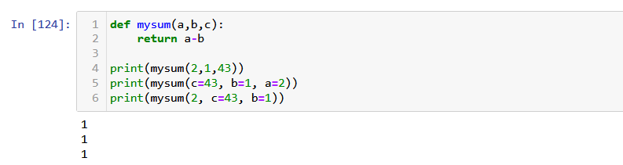
Keyword Arguments
Functions can be called with arguments out of order:

Slide 100
Iterables and the Map Function
An iterable is a Python object that can be used as a sequence (list, tuple, etc.)
map() function returns a map object (which is an iterator) of the results after applying the given function to each item of a given iterable.
Syntax: map(fun, iter)
fun: Function to which map passes each element of a given iterable
iter: Iterable which is to be mapped

Slide 101
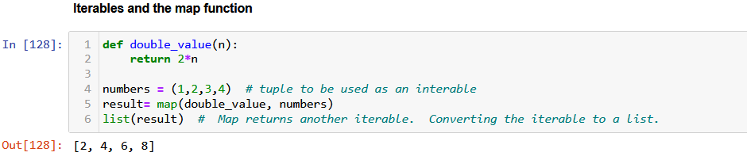
Iterables and the Map Function

Slide 102
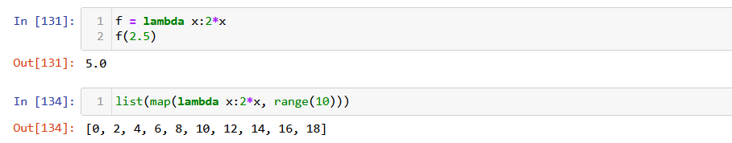
Lambda Functions
Python Lambda Functions are “anonymous” functions
Syntax: lambda arguments: expression
Often handy to use a lambda function in a map function:

Slide 103
Python Libraries

Slide 104
Python Libraries
Python is implemented and distributed via libraries
The Python Standard Library represents “base Python” and, together with the Python Language Reference, fully describes the basic Python language

Slide 105
Python Standard Library
Contains an extensive collection of components, for example:
math: Mathematical functions
cmath: Mathematical functions for complex numbers
decimal: Decimal fixed point and floating point arithmetic
fractions: Rational numbers
random: Generate pseudo-random numbers
statistics: Mathematical statistics functions

Slide 106
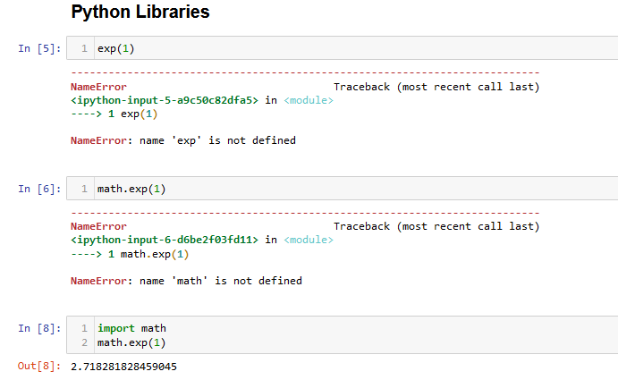
Using Standard Library Functions
We want to use the exp() function which is part of the Python math library.
We have to tell Ipython what library it belongs to
However, even though it’s part of a standard library, we must first import it into our notebook file

Slide 107
Third-Party Libraries
In addition to standard libraries, the Python ecosystem has a large number of third-party libraries
Several of these third-party libraries have become standard to use in data science applications:
NumPy (numerical Python): Adds high performance numeric arrays
Pandas (Python Data Analysis): Adds heterogeneous array types
Matplotlib: Basic plotting functions (from Matlab)
Seaborn: Ggplot-like plotting functions
Statsmodels: Statistical modeling (similar syntax to R)
Scikit-Learn: Implementation of many standard machine learning algorithms
TensorFlow: More complex library for distributed numerical computation

Slide 108
Revisiting Python Objects
Python is an object-oriented language
In Python, everything that can be named (variable, function, etc.) is an object
Every object has attributes
Methods can be applied to an object via the dot syntax
Objects have types (also referred to as classes)
Libraries often define new types/classes (which have associated attributes and methods)

Slide 109
Python Libraries
A library is a collection of high-level functions
Allow users to develop applications without having to code low-level details
In Python:
A library is a collection of one or more modules (Python files)
Modules are made of one or more classes
Classes include methods and attributes

Slide 110
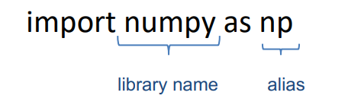
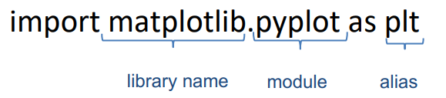
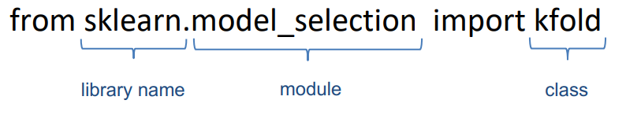
Importing Third-Party Libraries
There are several options for importing a library or part of a library:
Import the entire library
Import a specific module from a library
Import a specific class (with associated methods/attributes) from a module in a library

Slide 111
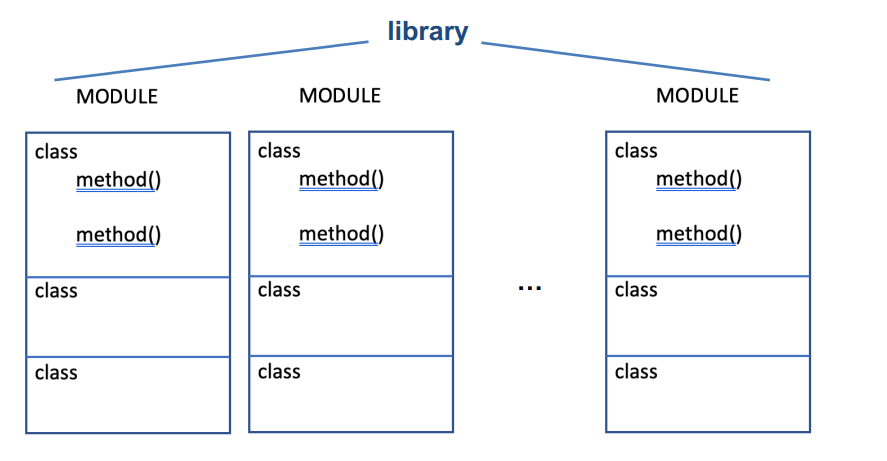
Python Libraries
Generic Library Structure and Notation
library
library.module
library.module.class
library.module.class.method()

Slide 112
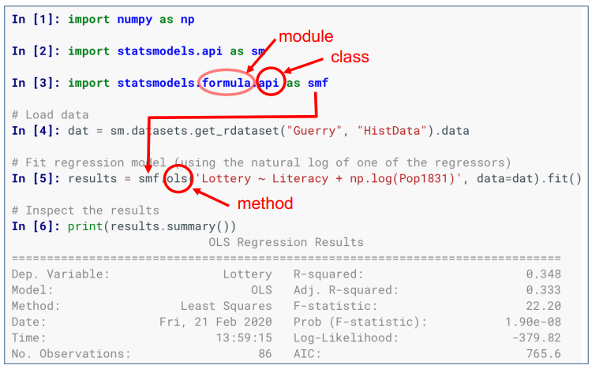
Example of Importing and Using a Library Function

Slide 113
NumPy

Slide 114
Data in the Python Data Science Ecosystem
Reminders
Basic Python provides three basic data types (numeric, string, Boolean) which can be structured in four basic structures:
List: Changeable (mutable) ordered sequence of mixed types
Tuple: Unchangeable (unmutable) ordered sequence of mixed types
Set: Unordered and unindexed collection of unique elements of mixed types
Dictionary: Ordered collection of key-value pairs of mixed types

Slide 115
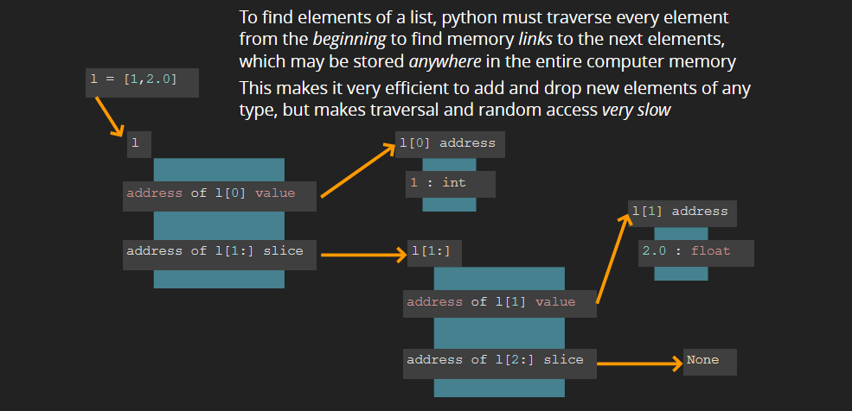
Data Structures: Basic Python
In order to provide the flexibility to handle mixed types, Python implements its data structures as linked lists:

Slide 116
A Partial Solution: NumPy (“Numerical Python”)
Python was not originally designed for numerical computing, but its other features quickly attracted the scientific and engineering community
NumPy provides a new core data type for large, homogenous, multi-dimensional arrays and matrices (“ndarrays”) along with a large collection of high-level mathematical functions to operate on these arrays.
Very similar to Matlab functionality
Most more modern data science packages, including Pandas, SciKitLearn, and TensorFlow are built on top of NumPy

Slide 117
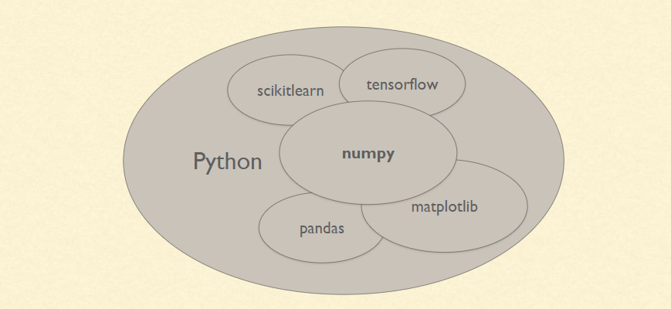
Libraries
NumPy and Pandas

Slide 118
NumPy
Library contents:
ndarray: an efficient multidimensional array type
Mathematical functions for fast operations on arrays without having to write loops
Linear algebra, random number generation, and other transforms

Slide 119
NumPy
Basic Functionality
Fast vectorized array operations for data manipulation and cleaning, subsetting and filtering, transformation, and many other kinds of computations
Common array algorithms like sorting, unique, and set operations
Efficient descriptive statistics and aggregating/summarizing data
Relational data manipulations for merging and joining heterogeneous datasets
Expressing conditional logic as array expressions instea of lloops
Group-wise data manipulations (aggregation, transformation, function application)

Slide 120
NumPy Overview
Outline
Creating NumPy arrays
Arithmetic with NumPy arrays
Accessing NumPy array data
Universal Functions (ufuncs)

Slide 121
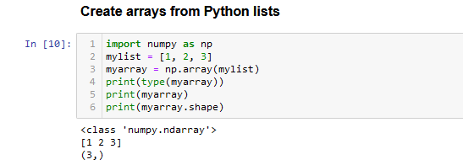
The NumPy ndarray (“NumPy Array”)
Creating a NumPy Array
The np.array function converts any sequence-like object to a NumPy array containing the passed data:

Slide 122
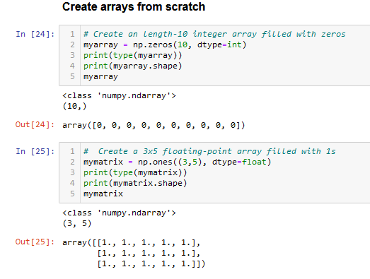
The NumPy ndarray (“NumPy Array”)
Creating a NumPy Array
Alternately, there are a number of numpy functions for creating new arrays:

Slide 123
NumPy Array Attributes
Function | Description
ndarray.shape | Tuple of array dimensions.
ndarray.ndim | Number of array dimensions.
ndarray.itemsize | Length of one array element in bytes.
ndarray.size | Number of elements in the array.
ndarray.dtype | Data-type of the array’s elements.
ndarray.T | The transposed array.
ndarray.real | The real part of the array.
ndarray.imag | The imaginary part of the array.
ndarray.flags | Information about the memory layout of the array.

Slide 124
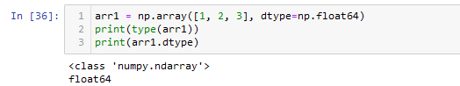
The NumPy ndarray (“NumPy Array”)
Data Types
The .dtype attribute returns the datatype of the elements in the NumPy array:

Slide 125
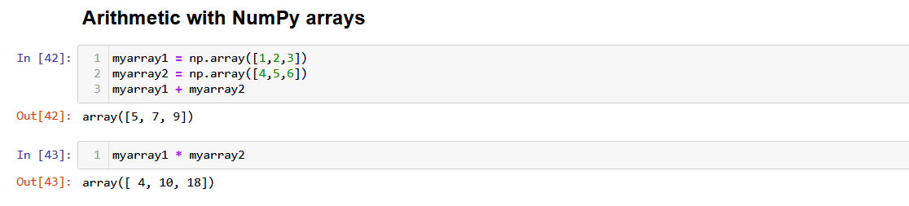
NumPy Overview
Arithmetic with NumPy Arrays

Slide 126
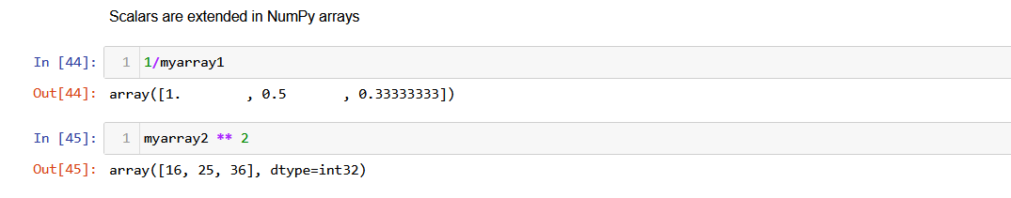
NumPy Overview
Arithmetic with NumPy Arrays

Slide 127
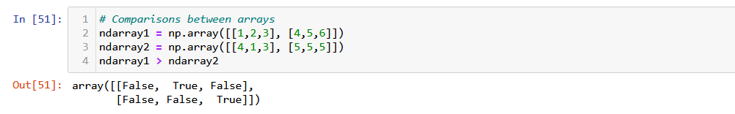
NumPy Overview
Arithmetic with NumPy Arrays

Slide 128

NumPy Overview
Accessing NumPy Array Data

Slide 129

NumPy Overview
Accessing NumPy Array Data

Slide 130

NumPy Overview
Accessing NumPy Array Data

Slide 131

NumPy Overview
Accessing NumPy Array Data

Slide 132

NumPy Overview
Accessing NumPy Array Data

Slide 133

NumPy Overview
Accessing NumPy Array Data

Slide 134

NumPy Overview
Accessing NumPy Array Data

Slide 135

NumPy Overview
Accessing NumPy Array Data

Slide 136

NumPy Overview
Accessing NumPy Array Data

Slide 137

NumPy Overview
Unary Universal Functions (ufuncs)

Slide 138

NumPy Overview
Unary Universal Functions (ufuncs)

Slide 139
Unary ufuncs (1 of 2)
Function | Description
abs, fabs | Compute the absolute value element-wise for integer, floating-point, or complex values
sqrt | Compute the square root of each element (equivalent to arr ** 0.5)
square | Compute the square of each element (equivalent to arr ** 2)
exp | Compute the exponent e^{x} of each element
log, log10, log2, log1p | Natural logarithm (base e), log base 10, log base 2, and log(1 + x), respectively
sign | Compute the sign of each element: 1 (positive), 0 (zero), or –1 (negative)
ceil | Compute the ceiling of each element (i.e., the smallest integer greater than or equal to that number)
floor | Compute the floor of each element (i.e., the largest integer less than or equal to each element)

Slide 140
Unary ufuncs (3 of 2)
Function | Description
rint | Round elements to the nearest integer, preserving the dtype
modf | Return fractional and integral parts of array as a separate array
isnan | Return boolean array indicating whether each value is NaN (Not a Number)
isfinite, isinf | Return boolean array indicating whether each element is finite (non-inf, non-NaN) or infinite, respectively
cos, cosh, sin, sinh, tan, tanh | Regular and hyperbolic trigonometric functions
arccos, arccosh, arcsin, arcsinh, arctan, arctanh | Inverse trigonometric functions
logical_not | Compute truth value of not x element-wise (equivalent to ~arr).

Slide 141

NumPy Overview
Binary Universal Functions (ufuncs)

Slide 142
Binary ufuncs (1 of 2)
Function | Description
add | Add corresponding elements in arrays
subtract | Subtract elements in second array from first array
multiply | Multiply array elements
divide, floor_divide | Divide or floor divide (truncating the remainder)
power | Raise elements in first array to powers indicated in second array
maximum, fmax | Element-wise maximum; fmax ignores NaN
minimum, fmin | Element-wise minimum; fmin ignores NaN

Slide 143
Binary ufuncs (2 of 2)
Function | Description
mod | Element-wise modulus (remainder of division)
copysign | Copy sign of values in second argument to values in first argument
greater, greater_equal, less, less_equal, equal, not_equal | Perform element-wise comparison, yielding boolean array (equivalent to infix operators >, >=, <, <=, ==, !=)
logical_and, logical_or, logical_xor | Compute element-wise truth value of logical operation (equivalent to infix operators & |, ^)

Slide 144

NumPy Overview
NumPy where() method

Slide 145
Pandas

Slide 146
The Rest of the Solution: Pandas
“Python Data Analysis Library”
Most data science datasets are heterogeneous (contain columns with different datatypes)
Pandas provides heterogeneous array types with naming for rows and columns:
Series: One-dimensional array
Dataframes: Multi-dimensional array
It also contains a third data structure known as an Index Object

Slide 147
Pandas Overview
Series Objects
A Series is a one-dimensional array-like object containing:
A sequence of values (similar to NumPy arrays)
An associated array of data labels called its index

Slide 148

Pandas Overview
Series Objects (Default Index Values)
Index
Values

Slide 149

Pandas Overview
Series Objects: User-Specified Index
Index
Values

Slide 150

Pandas Overview
Using Index Labels to Select Values or Sets of Values
Note notation. Series takes a list of index values as a single parameter.

Slide 151

Pandas Overview
Series Arithmetic Examples
Returns an array of Booleans

Slide 152

Pandas Overview
Series Arithmetic Examples

Slide 153

Pandas Overview
Dictionary Functions

Slide 154

Pandas Overview
Creating Series From Python Dictionary

Slide 155

Pandas Overview
Specifying the Index Order
No value for “California” was found, so NaN (not a number) was returned

Slide 156

Pandas Overview
Testing for NaNs
Available in Pandas as a function or a method (equivalent)

Slide 157

Pandas Overview
Automatic Alignment by Index Label

Slide 158

Pandas Overview
Both Series and its Index Have Names

Slide 159
Pandas Dataframes
The primary data structure used in data science
Designed for working with tabular, heterogeneous data
Consists of a number of Pandas series “glued together” with a common index
Every column (series) must be of the same length

Slide 160

Pandas Dataframes

Slide 161

Pandas Dataframes
Creating Dataframe From Python Dictionary

Slide 162

Pandas Dataframes
Retrieving Pandas Series From Dataframe Columns

Slide 163

Pandas Dataframes
Retrieve Rows by Row Number

Slide 164

Pandas Dataframes
Retrieve Rows by Content

Slide 165

Pandas Dataframes
Modifying or Creating Columns by Assignment

Slide 166

Pandas Dataframes
Adding a New Column of Booleans Based on Conditional Test

Slide 167

Pandas Dataframes
Deleting a Column

Slide 168

Pandas Dataframes
Values Attribute
As with Series, the values attribute returns the data contained in a DataFrame as a two-dimensional ndarray:

Slide 169

Pandas Dataframes
Transforming a Dataframe

Slide 170

Pandas Dataframes
Creating a Dataframe From NumPy Arrays and Python Lists

Slide 171
Pandas Index Objects
Pandas index objects hold the axis labels and other meta-data (like the axis name or names)
Any array or sequence used when constructing a Series of a DataFrame is automatically converted to an an Index:

Slide 172

Pandas Index Objects

Slide 173

Pandas Index Objects
Index Objects are Immutable

Slide 174

Basic Pandas Functionality
Reindexing

Slide 175

Basic Pandas Functionality
Dropping Entities from an Axis - Series

Slide 176

Basic Pandas Functionality
Dropping Entities from an Axis - DataFrame

Slide 177

Basic Pandas Functionality
Dropping Entities from an Axis - DataFrame

Slide 178

Basic Pandas Functionality
Indexing, Selection, and Filtering - Series
Series indexing works similar to NumPy arrays except that you can use the Series’s index values instead of only integers:

Slide 179

Basic Pandas Functionality
Indexing, Selection, and Filtering - Series

Slide 180

Basic Pandas Functionality
Indexing, Selection, and Filtering - Series

Slide 181

Basic Pandas Functionality
Indexing, Selection, and Filtering - Dataframe

Slide 182

Basic Pandas Functionality
Indexing, Selection, and Filtering - Dataframe
Returns a series
Returns a dataframe

Slide 183

Basic Pandas Functionality
Indexing, Selection, and Filtering - Dataframe

Slide 184

Basic Pandas Functionality
Indexing, Selection, and Filtering - Dataframe

Slide 185

Basic Pandas Functionality
Indexing, Selection, and Filtering - Dataframe
Selection with loc (using axis labels) and iloc (using integers):

Slide 186

Basic Pandas Functionality
Indexing, Selection, and Filtering - Dataframe
Selection with loc (using axis labels) and iloc (using integers):

Slide 187

Basic Pandas Functionality
Indexing, Selection, and Filtering - Dataframe
Indexing functions with slices

Slide 188
Basic Pandas Functionality
Indexing Options with DataFrames
Type | Notes
df[val] | Select single column or sequence of columns from the DataFrame; special case conveniences: boolean array (filter rows), slice (slice rows), or boolean DataFrame (set values based on some criterion)
df.loc[val] | Selects single row or subset of rows from the DataFrame by label
df.loc[:, val] | Selects single column or subset of columns by label
df.loc[val1, val2] | Select both rows and columns by label
df.iloc[where] | Selects single row or subset of rows from the DataFrame by integer position
df.iloc[:, where] | Selects single column or subset of columns by

Slide 189
Basic Pandas Functionality
Indexing Options with DataFrames
Type | Notes
df.iloc[:, where] | Selects single column or subset of columns by integer position
df.iloc[where_i, where_j] | Select both rows and columns by integer position
df.at[label_i, label_j] | Select a single scalar value by row and column label
df.iat[i, j] | Select a single scalar value by row and column position (integers)
reindex method | Select either rows or columns by labels
get_value, set_value methods | Select single value by row and column label

Slide 190

Basic Pandas Functionality
Arithmetic and Data Alignment
Arithmetic operations between Series or Dataframes with different indexes requires special handling:

Slide 191

Basic Pandas Functionality
Arithmetic and Data Alignment - Dataframes

Slide 192

Basic Pandas Functionality
Arithmetic and Data Alignment - Dataframes

Slide 193

Basic Pandas Functionality
Function Application and Mapping
NumPy ufuncs also work with Pandas objects:

Slide 194

Basic Pandas Functionality
Function Application and Mapping
In addition, the datagrame .apply method applys a function on one-dimensional arrays to each column or row:

Slide 195

Basic Pandas Functionality
Sorting Series by Index

Slide 196

Basic Pandas Functionality
Sorting Dataframes by Index

Slide 197

Basic Pandas Functionality
Sorting Series by Values

Slide 198

Basic Pandas Functionality
Sorting Dataframe by Values in Single Column

Slide 199

Basic Pandas Functionality
Sorting Dataframe by Values in Multiple Columns

Slide 200
Pandas Overview
Summarizing and Computing Descriptive Statistics
Pandas objects include a set of common mathematical and statistical methods
Most are summary statistics which extract a single value (like a mean) from a Series or from rows or columns of dataframes.
Methods include built-in handling for missing data

Slide 201

Pandas Overview
Summarizing and Computing Descriptive Statistics

Slide 202

Pandas Overview
Summarizing and Computing Descriptive Statistics

Slide 203

Pandas Overview
Summarizing and Computing Descriptive Statistics

Slide 204

Pandas Overview
Summarizing and Computing Descriptive Statistics

Slide 205
Pandas Overview
Summarizing and Computing Descriptive Statistics
Method | Description
count | Number of non-NA values
describe | Compute set of summary statistics for Series or each DataFrame column
min, max | Compute minimum and maximum values
argmin, argmax | Compute index locations (integers) at which minimum or maximum value obtained, respectively
idxmin, idxmax | Compute index labels at which minimum or maximum value obtained, respectively
quantile | Compute sample quantile ranging from 0 to 1
sum | Sum of values
mean | Mean of values
median | Arithmetic median (50% quantile) of values

Slide 206
Pandas Overview
Summarizing and Computing Descriptive Statistics
Method | Description
mad | Mean absolute deviation from mean value
prod | Product of all values
var | Sample variance of values
std | Sample standard deviation of values
skew | Sample skewness (third moment) of values
kurt | Sample kurtosis (fourth moment) of values
cumsum | Cumulative sum of values
cummin, cummax | Cumulative minimum or maximum of values, respectively
cumprod | Cumulative product of values
diff | Compute first arithmetic difference (useful for time series)
pct_change | Compute percent changes

Slide 207

Pandas Overview
Unique Values, Value Counts, and Membership

Slide 208

Pandas Overview
Unique Values, Value Counts, and Membership

Slide 209

Pandas Overview
Unique Values, Value Counts, and Membership

Slide 210
Pandas Overview
Unique Values, Value Counts, and Membership Methods
Method | Description
isin | Compute boolean array indicating whether each Series value is contained in the passed sequence of values
get_indexer | Compute integer indices for each value in an array into another array of distinct values; helpful for data alignment and join-type operations
unique | Compute array of unique values in a Series, returned in the order observed
value_counts | Return a Series containing unique values as its index and frequencies as its values, ordered count in descending order

Slide 211
Reading Data From Files

Slide 212

Python Basics
Loading CSV Files Using Pandas

Slide 213

Python Basics
Loading CSV Files Using Pandas

Slide 214

DataFrame Objects
Cars Dataset

Slide 215

read_csv example
Cars Dataset
Skip the first 3 rows

Slide 216
Plotting with Matplotlib and Seaborn

Slide 217
Data Visualization
Matplotlib Package
Python 2D plotting library which produces publication quality figures in a variety of hardcopy formats
A set of functionalities similar to those of MATLAB
Line plots, scatter plots, barcharts, histograms, pie charts etc.
Relatively low-level; some effort needed to create advanced visualization
https://matplotlib.org/

Slide 218
Data Visualization
Seaborn Package
Based on Matplotlib
Provides high-level interface for drawing attractive statistical graphs
Similar (in style) to the popular ggplot2 library in R
https://seaborn.pydata.org/

Slide 219
Matplotlib Basics
General usage
Call a plotting function with some data – for example, plot()
Call multiple functions to configure various properties of the plot (color, labels, etc.)
Make the plot visible – show()
For this lecture, I use the following “standards”:
Use the classic Matplotlib style: plt.style.use(‘classic’)
Use the “inline” mode (not the “notebook”) mode:
%matplotlib inline
Figures can be saved to files using the savefig() method:
fig.savefig(‘my_figure.png’)

Slide 220
Basic Matplotlib Visualizations
Univariate
Histograms
Density Plots
Box and Whisker Plots
Multivariate
Scatter Plots
Correlation matrices

Slide 221

Matplotlib Examples

Slide 222

Matplotlib Examples

Slide 223

Matplotlib Examples

Slide 224

Matplotlib Examples

Slide 225

Matplotlib Examples

Slide 226

Matplotlib Examples

Slide 227

Matplotlib Examples

Slide 228

Matplotlib Examples

Slide 229

Matplotlib Examples

Slide 230

Matplotlib Examples
Seaborn Version

Slide 231

Matplotlib Examples

